Slide 1
Legal Protection Against the Automation of Law?
Prof. Mireille Hildebrandt
Vrije Universiteit Brussels (Law)
Radboud University Nijmegen (CS)

Slide 3
Qu’est-ce qu’une information susceptible de traitement automatique?
tout ensemble d’éléments numériques, alphabétiques, ou symboliques, dont le sens est explicite ou obtenue par référence a une table de correspondance
toute donnée quantifiable ou mesurable (par exemple un cout un rendement)
Seules font exception, en général, mais pas toujours, les données purement qualitatives (par exemple un jugement, une appreciation)
Pierre Mathelot, L’Informatique, Que sais-je?, PUF 1969, 7
Librarie J. Vrin, Place de la Sorbonne, 20 mars 2019, 1 euro

Slide 4
What’s next?
Transformation of legal norms into self-executing script
Legal decision-making based on prediction of similar cases
Law, public administration or technological management?
What legal remedies offer ‘practical and effective’ legal protection?

Slide 5
Legal norms as self-executing script?
Why a self-executing script is not necessarily a contract:
Buterin: ‘neither contract nor smart’ (persistent script)
Contracts are based on informed agreement, offer & acceptance
Such agreement can be spoken, written, signed by the notary public
Does this imply it can be written in code?
NO: difference between programming languages and human language
Can one be legally bound by the code?
This will be in part a factual question:
can one infer the intent to be bound from accessing the code?
does the code ‘do’ what a party could have reasonably expected?
do changing circumstances interfere with these expectations?

Slide 6
Legal norms as self-executing script?
Why a self-executing script does not equate with a valid public administrative decision:
The validity of a decision depends on its legality (justification)
This is a matter of competence, and potentially of discretion (within set boundaries)
Self-executing script conflates standard-setting with execution and interpretation
This violates the checks and balances of the Rule of Law
Here those who coded the software are legislature, public administration and court
In EU these will be automated decisions in the sense of art. 22 GDPR
Default prohibition, unless one of 3 exceptions applies
Requires notification, explanation and the ability to contest
Translating standards into formalized rules results in over- and under-inclusion
Formalized rules are non-ambiguous and thus not adaptive

Slide 7
Legal decision-making as prediction based on similar cases
Holmes:
The prophecies of what the courts will do in fact,
and nothing more pretentious,
are what I mean by the law.

Slide 10
Assumption: text extracted from published judgments are a proxy for applications lodged with the Court
why? published judgments = low hanging fruit
problem: as authors state, facts may be articulated by court to fit the conclusion

Slide 12
Cases held inadmissible or struck out beforehand are not reported, which entails that a text-based predictive analysis of these cases is not possible.
why? admissible cases = low hanging fruit
problem: these cases would probably make a difference which now remains invisible

Slide 14
Data on cases related to art. 3, 6, 8 ECHR
why? provided the most data to be scraped, and sufficient cases for each
problem: impact of framing of the case remains invisible (think e.g. art. 5, 7, 9, 10, 14)

Slide 16
Dataset = publicly available
for each article: all cases [apart from non-English judgments]
equal amount of violation/non-violation cases
text extraction by using regular expressions, excluding operative provisions

Slide 17
Prediction is defined as a binary classification task: yes/no violation:
using each set of textual features to train SVM classifiers
linear kernal to check the weight learned for each feature
violation cases labelled +1, non-violation labelled -1
features with positive weights indicative of violation, with negative indicative of non-violation
trained and tested by 10-fold cross validation, a held-out of 10% for testing
performance computed as mean accuracy after 10-fold cross-validation

Slide 18
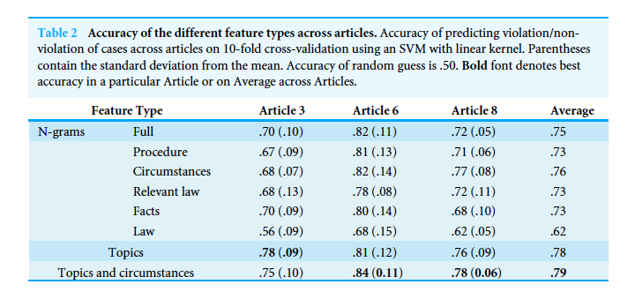

Slide 19
Circumstances and topics are best predictors, combined works best
law has lowest performance
discussion: facts more important than law
legal formalism and realism: evidence that legal realism is realistic

Slide 20
This is nonsense for 2 reasons:
as indicated by the authors the facts, formulated by the court, may be tuned to the outcome
in many cases there is no law section due to an inadmissibility judgment
To seriously make sense, one would need the facts of ‘cases’ that did not reach the court…

Slide 32
Legal decision-making as prediction based on similar cases
Holmes:
The prophecies of what the courts will do in fact,
and nothing more pretentious,
are what I mean by the law.

Slide 33
Law, public administration or technological management?
So, could prediction of judgement by ML applications be qualified as law?
Does it matter?
If law: legal effect based on prediction machines
If not law: public administration or technological management?
Defining law is lie nailing a pudding to the wall (Uwe Wesel)

Slide 34
Law, public administration or technological management?
Modern law is based on the performativity of (written) speech acts
Legal effect is not same as enforcement or mechanical application
Legal certainty is not same as ruthless consistency
Text-driven normativity makes interpretation the hallmark of modern law
The inherent ambiguity generates law’s contestability
Performativity concerns the constitutive not the causal or logical nature of legal effect and legal certainty

Slide 35
Law, public administration or technological management?
Predictive and explorative legal tech (including argumentation mining):
Involves performance instead of performativity
It is about metrics and formalization
Is about inductive inferences based on a series of design choices

Slide 37
“Officials at the Swedish Public Employment Service (Arbetsförmedlingen) started looking into the system after they noticed it was failing to generate letters to welfare claimants that had been expected. When they finished their review last year they found major shortcomings, with between 10% and 15% of the computer’s decisions likely to have been incorrect, SVT reported.
It is unclear whether it will be possible to identify and correct the erroneous decisions, and when exactly the problem started.”

Slide 38
The government brought in the computer system to automate the process of checking that people receiving a certain type of unemployment benefit keep up their obligations – and issuing warnings or withholding their payments if they don’t. This was supposed to increase efficiency, but since last Autumn the system has been switched off and human bureaucrats brought back in to sort out the mess.
The news comes just three weeks after the employment service announced it was laying off up to 4,500 of its 13,500 employees. The service cited a budget cut of SEK 800 million (€75 million) between 2018 and 2019. Mikael Sjöberg, Director General, was quoted in a release saying: “The renewal of the authority and the digitization we have carried out has laid a good foundation for continuing to deliver at a high level”.

Slide 39
What legal remedies offer ‘practical and effective’ legal protection?
Automation of law is not law
Both the code that is implemented and the decisions taken are under the Rule of Law
Practical and effective legal protection concerns
Obtaining human intervention
with understanding of decision and competence to change it
A new legal hermeneutics
Based on close reading of the result of distant reading of legal text

